Slide 1

Ministry In Mind
Jon Edmiston
Director of Creative Technologies

Slide 2

Ministry In
Mind
Taking Back
the Strategy
Notes:
Renewed Vision then Renewed Strategy

Slide 3
When you think IT vision…

Slide 4


Slide 5


Slide 6
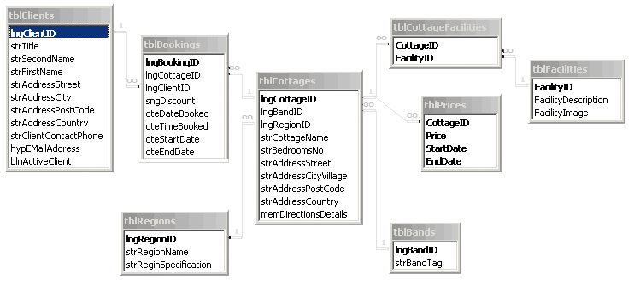

Slide 7


Slide 8
Mission: Help people to grow closer to God.
Notes:
Mission of the church is to grow people closer to God. What then should be the main mission of the ChMS?

Slide 10
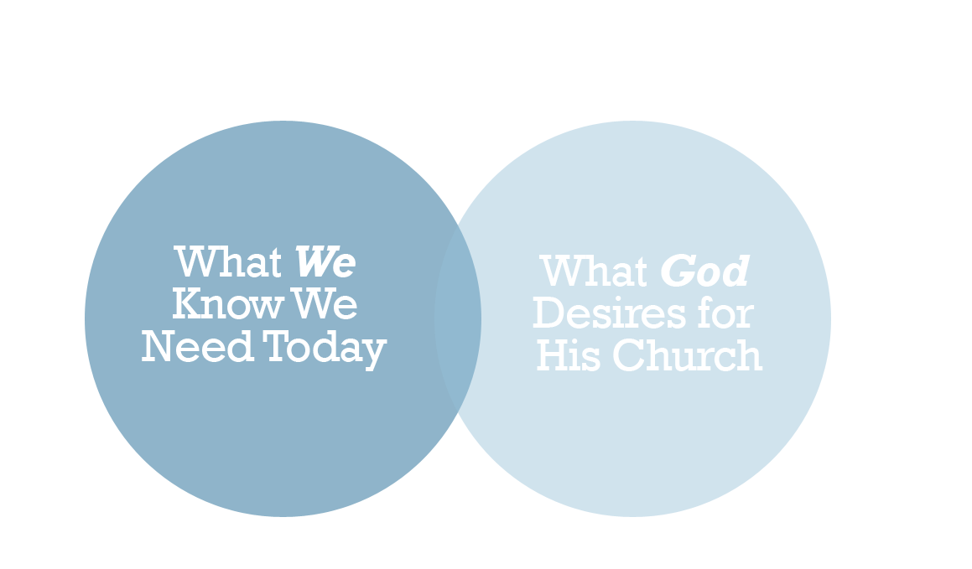
What We Work On

Slide 11


Slide 12

How To Care For Sheep
Is the sheep here?
Is the sheep healthy?
Is the sheep happy?
Do the sheep meet all government requirements?
How is the ranch running?

Slide 13

Sometimes Reality Is…
How is the ranch running?
Do the sheep meet all government requirements?
Is the sheep happy?
Is the sheep healthy?
Is the sheep here?

Slide 14

Notes:
Some of our reasons for doing things are plain odd. We all have them… we can see other peoples but it’s hard to see our own.

Slide 16

Notes:
One part discipline and get ‘er done, organize people in a logical and efficient manner.

Slide 17
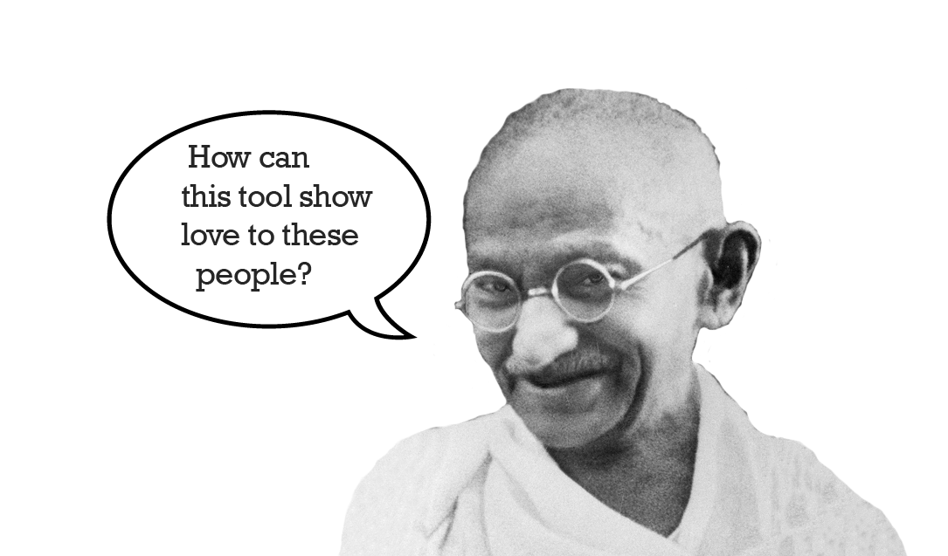
Notes:
Compassion and love.

Slide 18
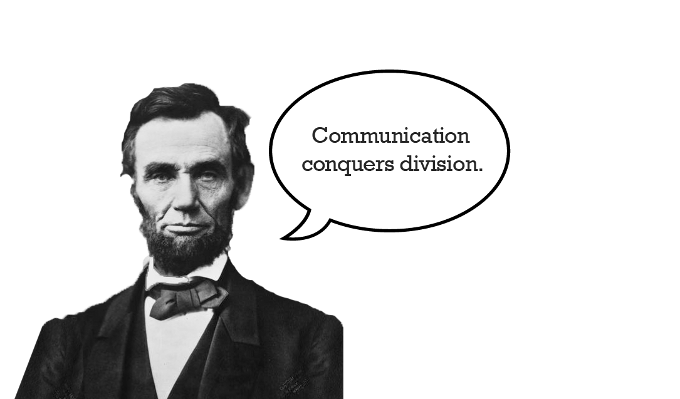
Notes:
A house divided cannot stand…

Slide 19


Slide 20
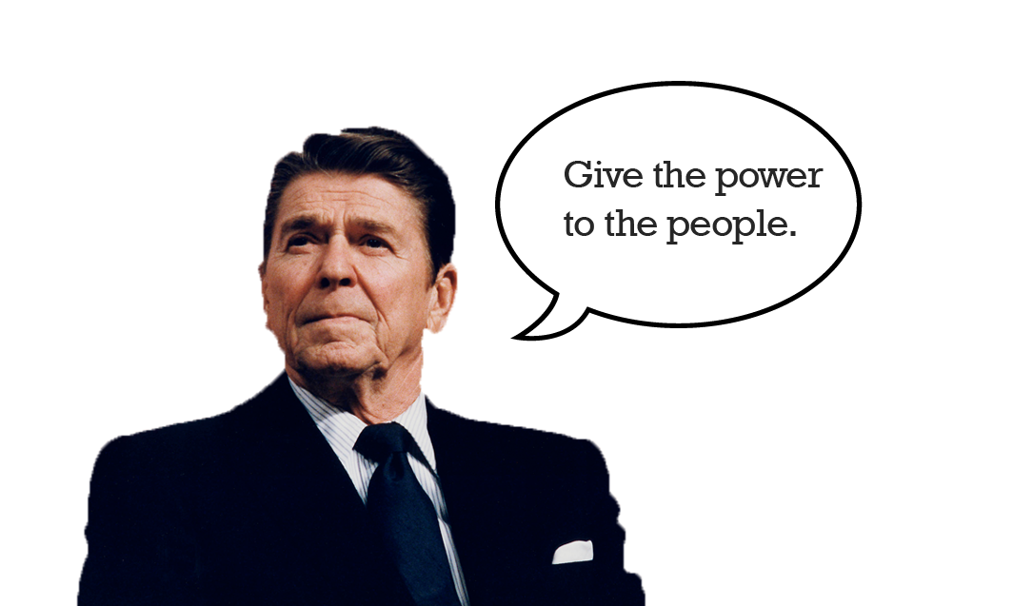

Slide 21
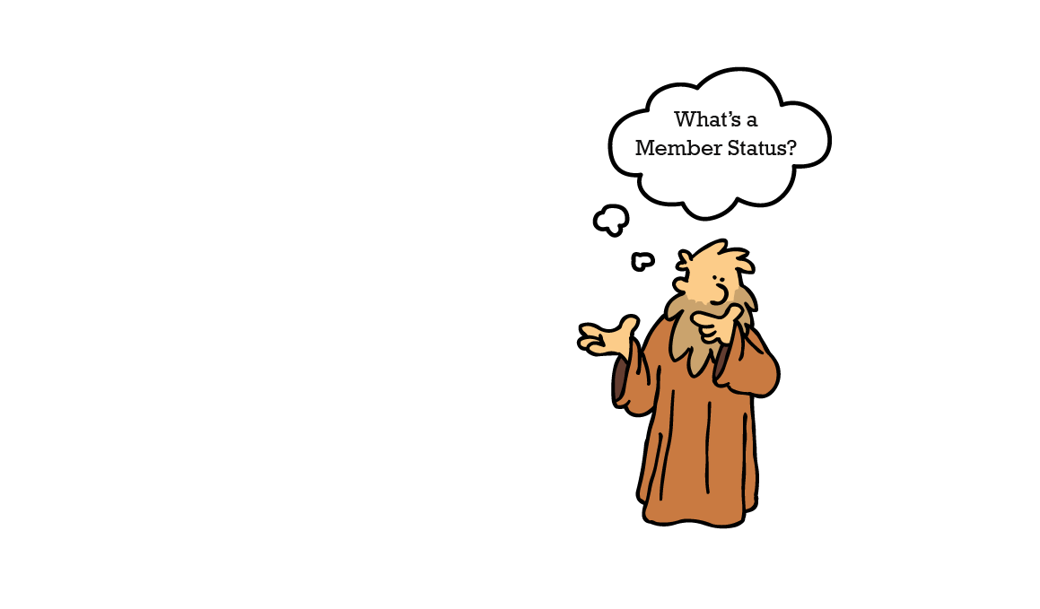

Slide 23
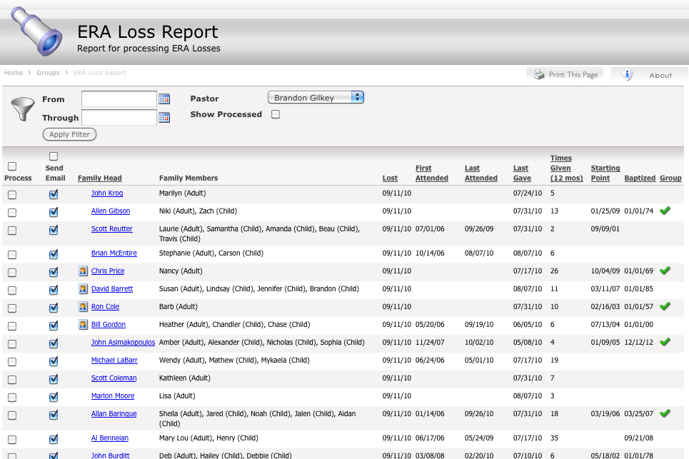

Slide 24
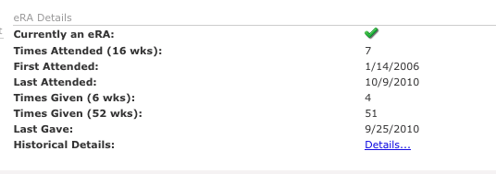

Slide 25
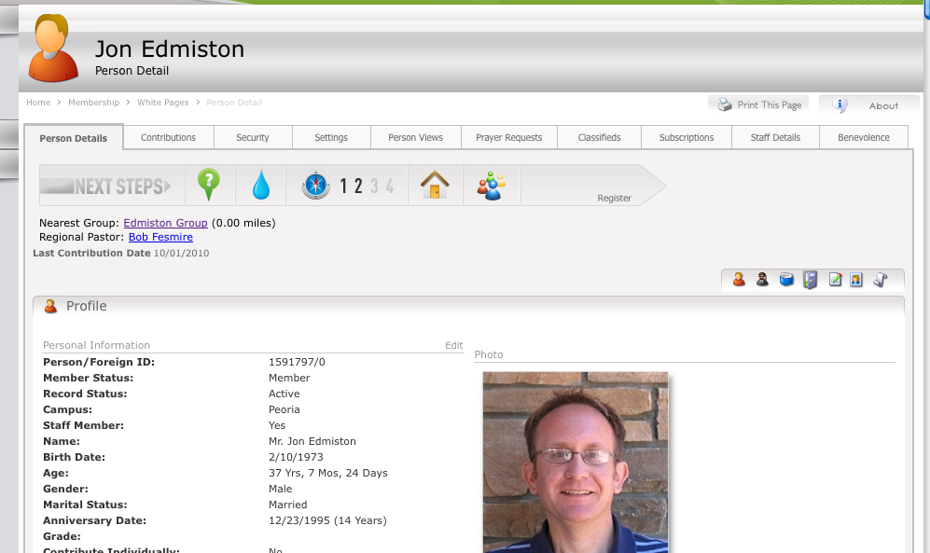

Slide 26
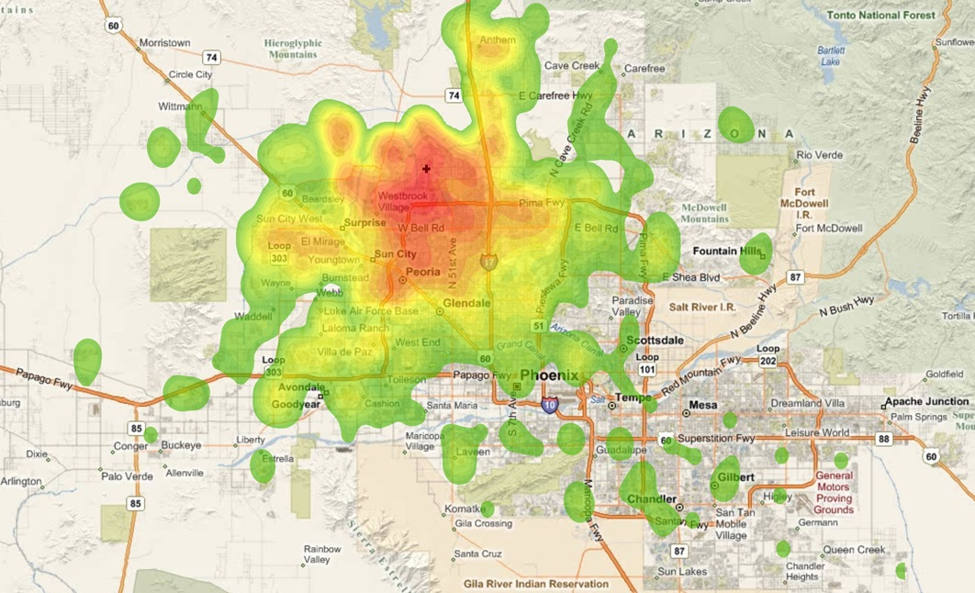

Slide 27
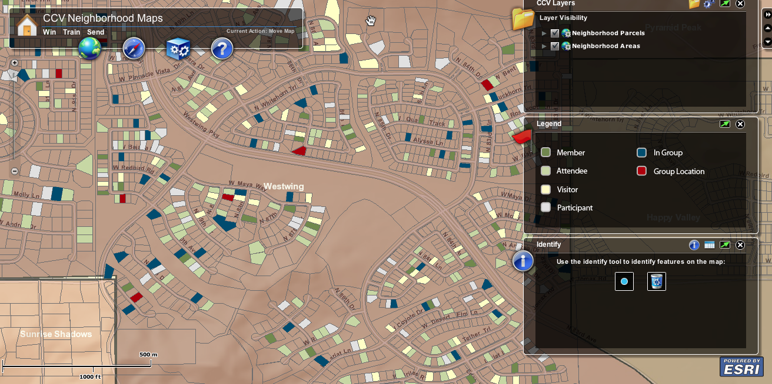

Slide 28


Slide 29


Slide 30
Ministry In
Mind
Taking Back
the Strategy
Notes:
Renewed Vision then Renewed Strategy

Slide 31


